Slide 1
Cargo MPS Task Group Updates

Slide 2
Agenda
Background
Fire Scenarios
Additional Topics of Interest
Future for the Standard

Slide 3
Background
Task group assembled to discuss issues with the standard
  Clarification of procedures
  Improve upon and add details to the acceptance criteria
  Add details to briefly mentioned topics

Slide 4









Task Group Participants

Slide 5
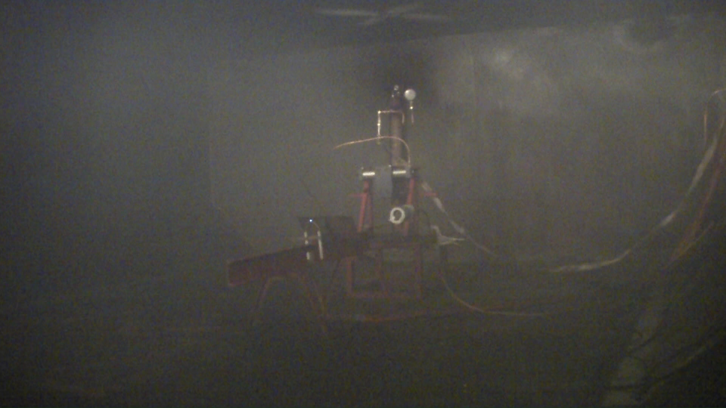
Meggitt Blend D
Notes:
Min inerting concentration at the ignitors was achieved, but the concentration at the ceiling was lower than the MIC.

Slide 6
Aerosol Can Explosion Simulation
Criteria for the Aerosol Can Simulator is stricter than what was tested in the MPS development tests with Halon 1301.
“The criterion for the aerosol can explosion simulation scenario is that there is no evidence of an explosion or reaction. Evidence of an explosion or reaction includes deflagrations, flashes, and overpressures, etc. There shall be no overpressures (zero pressure rise). In addition, when the agent concentration is below its inert concentration, the explosion intensity and peak pressures shall not be greater than the values exhibited during an explosive event when no suppression agent is present in the compartment.” – §Acceptance Criteria, 2012 MPS Document
“There was no ignition of the contents of the simulator in four of the five tests. There was a very brief ignition of some of the contents during one test (test 28), but no overpressure was recorded.” - §4.8, 2000 MPS Development Report

Slide 7
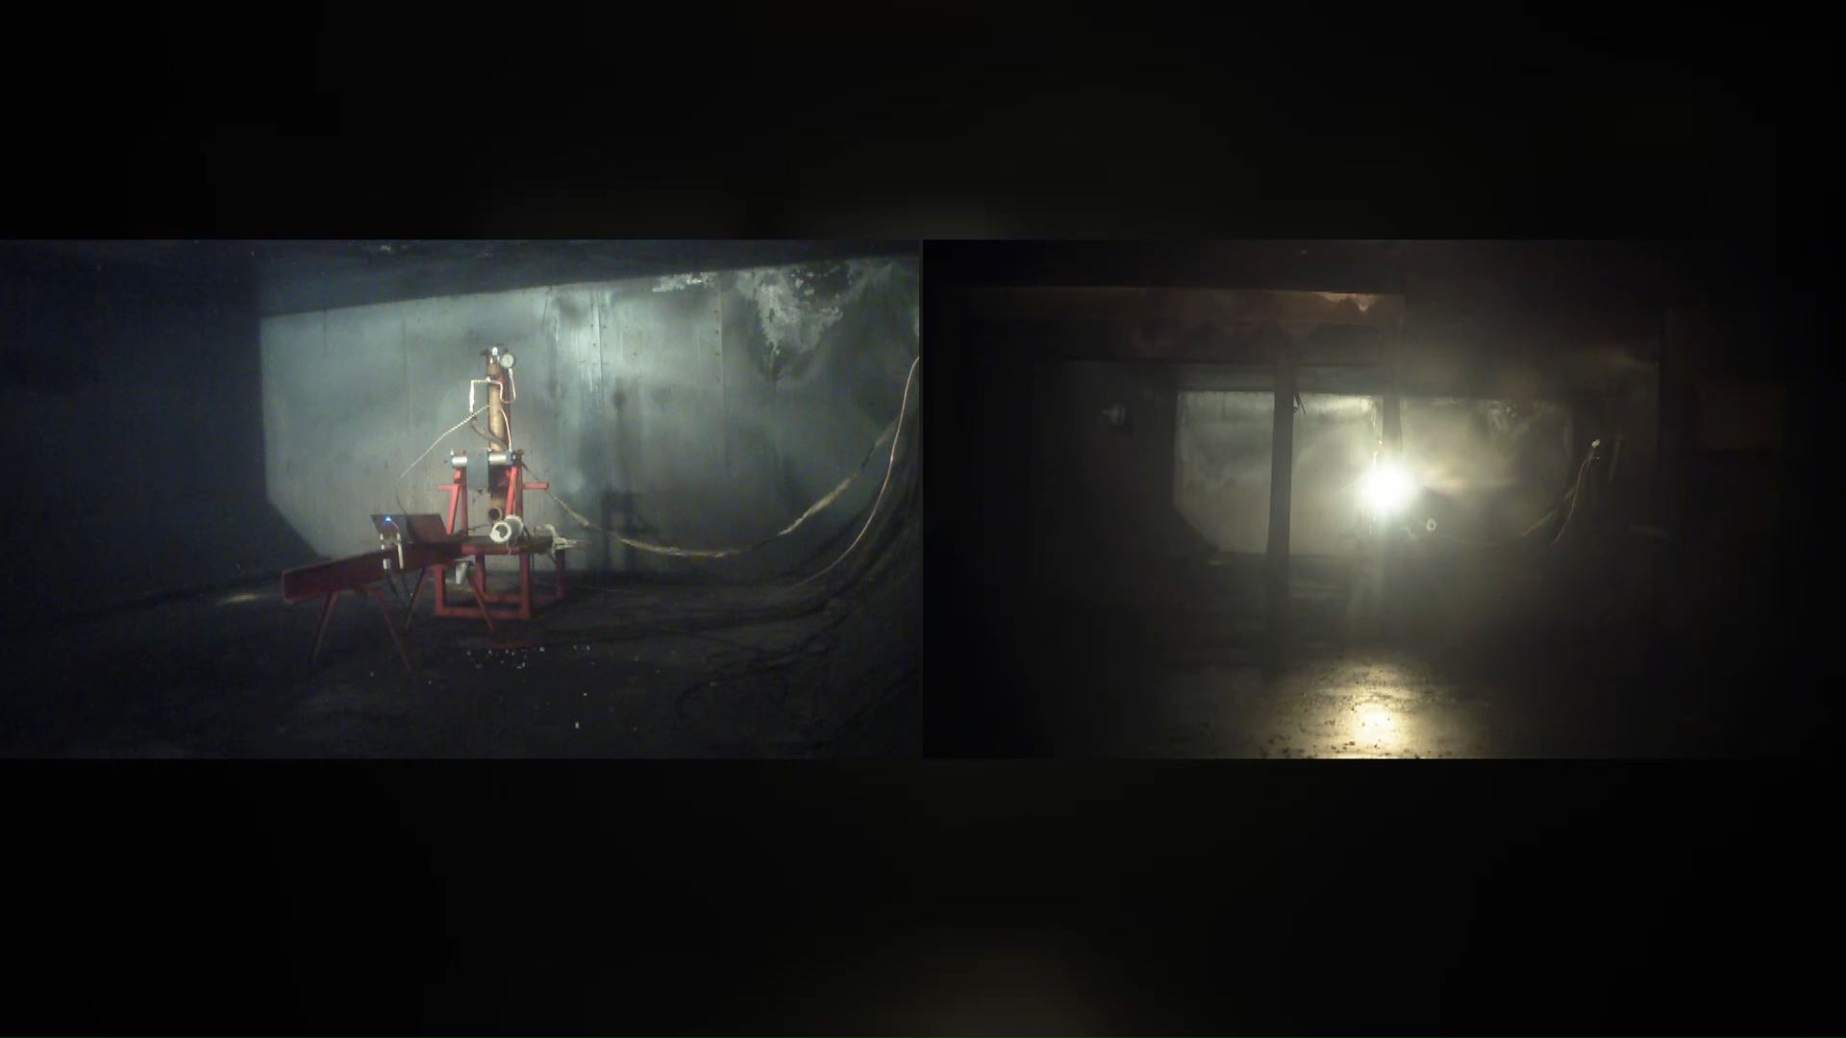
Halon 1301- Test 4
Overpressure of 0.045 psi

Slide 8
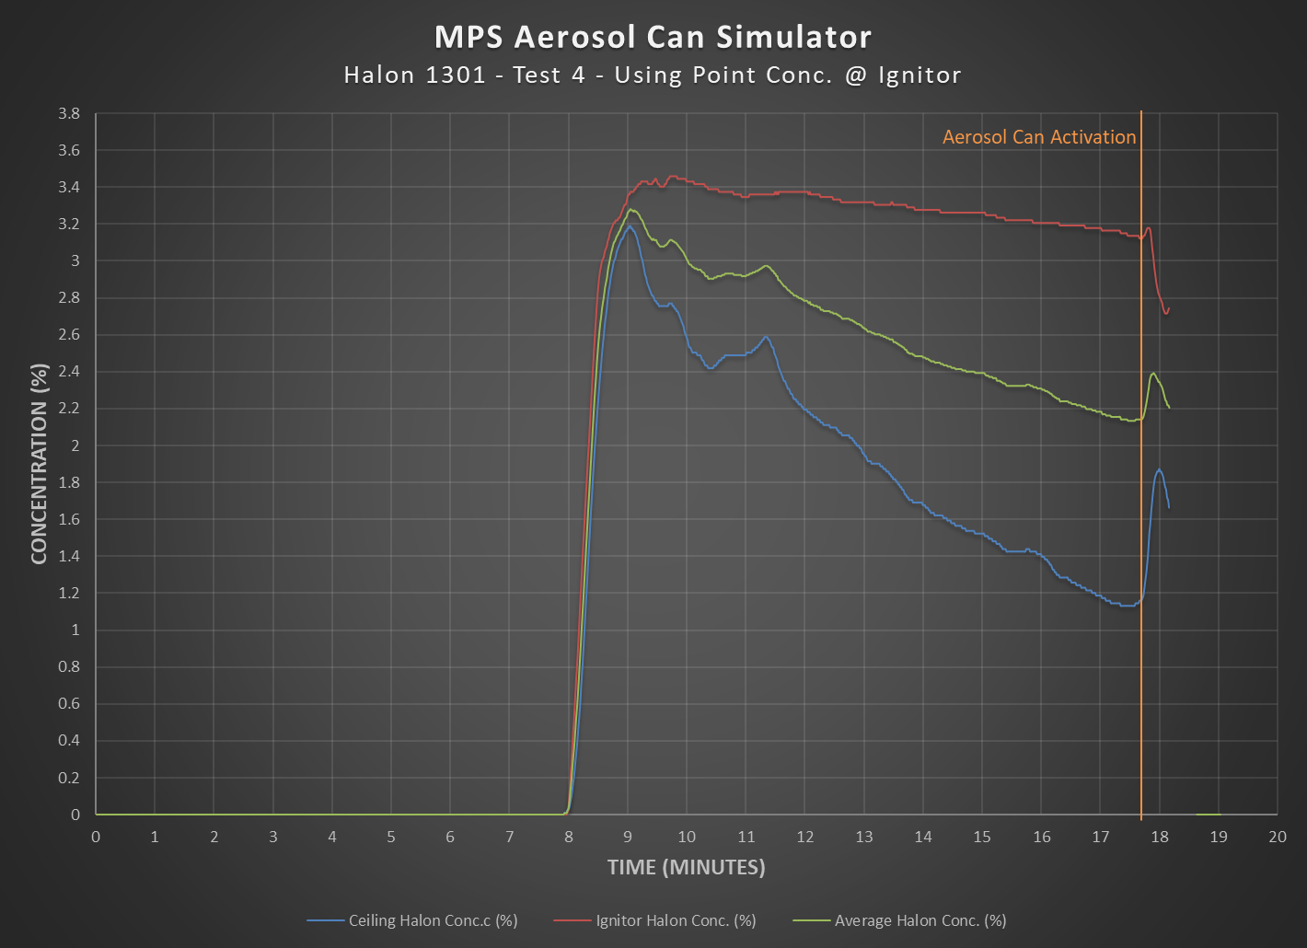
64.70% SD
Notes:
Issues: Simulator was not within its required pressure. Might need to rerun the test.

Slide 9
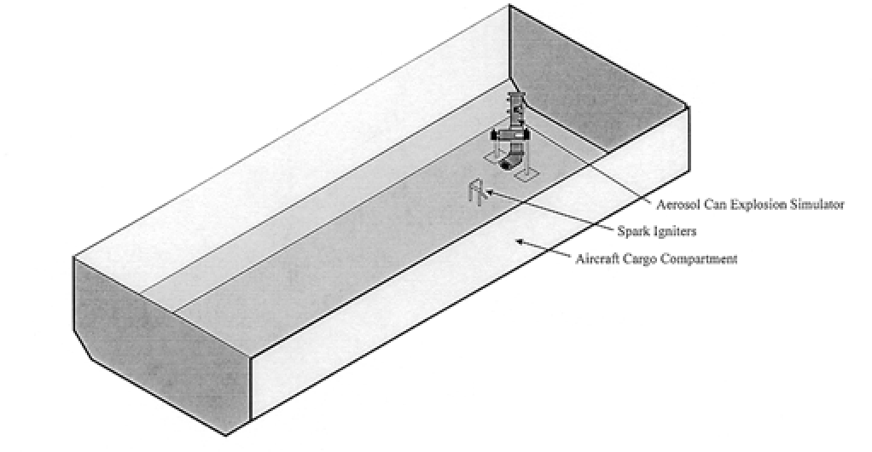

Aerosol Can Explosion Simulation
Mixing Fans

Slide 10

Mixing Fans Test Video – Test 14

Slide 11
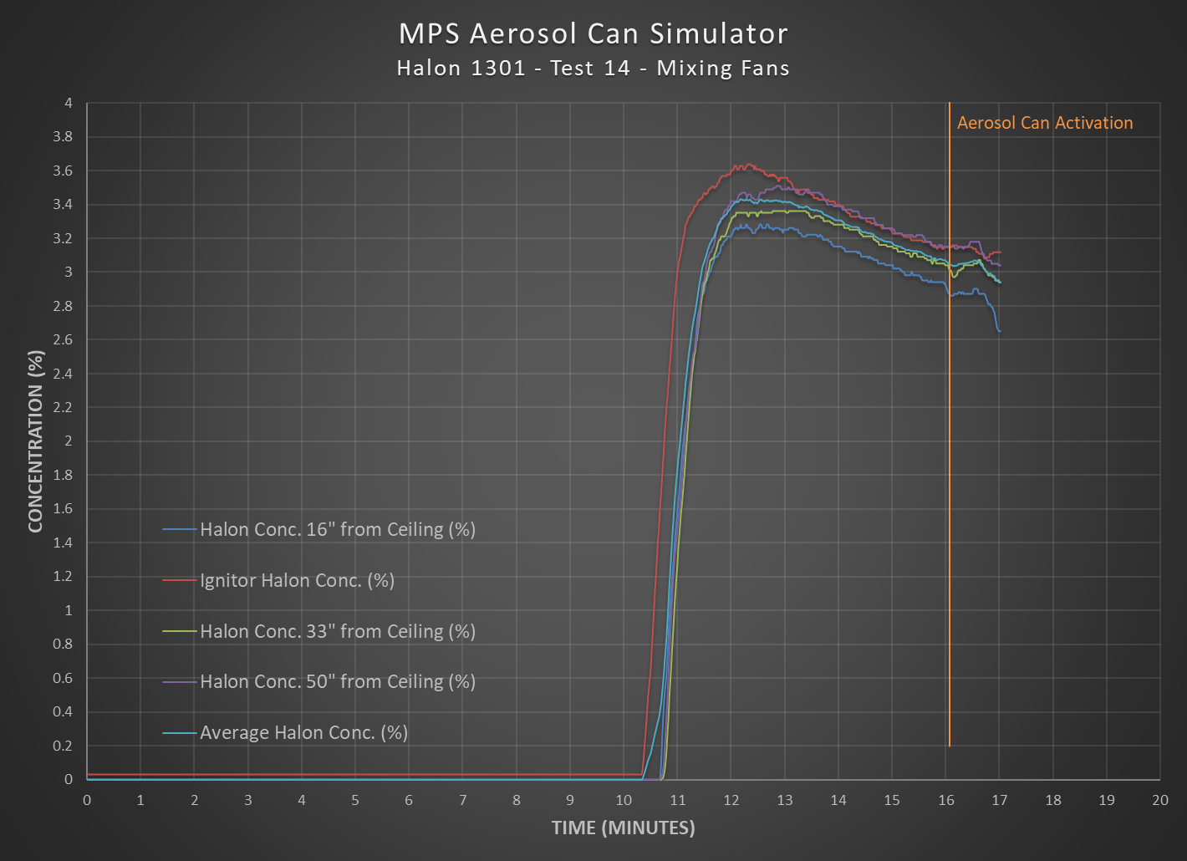
3.88% SD

Slide 12
Aerosol Can Explosion Simulation
Test Acceptance Criteria
  “The criterion for the aerosol can explosion and reaction simulation scenario is that there is no evidence of an explosion or unacceptable reaction. Evidence of an explosion is that there shall be no pressure rise more than the measurement of the baseline simulator pressure release into a compartment. The baseline test shall be conducted at least three times in the presence of the agent being tested without an ignition source. The baseline pressure will be calculated as the maximum value of the conducted tests and one standard deviation. The criteria of an unacceptable reaction is based on the observed performance with Halon 1301. With Halon 1301 it is typical to see evidence of a local flame or illumination near the ignitor in most tests and to see a small flash in 1 of 5 tests. The small flash involved a flame that separated from the ignitor and spread about 2 feet and self-extinguished in 2 seconds. In the event of more than one test having a "small flash" event, it is acceptable to perform additional tests to demonstrate that the frequency of these events is not greater than 20%. In addition, when the agent concentration is below its inert concentration, the explosion intensity and peak pressures shall not be greater than the values exhibited during an explosive event when no suppression agent is present in the compartment. To find more information on this subject, refer to reference 2.”

Slide 13
Aerosol Can Explosion Simulation
Simulator Volume
  Re-measured the simulator to clarify the details in the document
Pressure Transducer
  Transducer Range: 0-2psi
  Sampling Frequency: 100 Hz
Test Methodology
  Fans utilized to maintain the minimum protection concentration with the compartment.

Slide 14
Aerosol Can Explosion Simulation
Short Version
  The short-test protocol version is the primary test protocol version for conducting this test. The long-test protocol version of the test will be permitted only on a case by case basis after the authorities have reviewed a justification provided by the applicant.

Slide 15
Surface Burning Fire Scenario
Positioning of the pan can affect the peak temperatures and time-temperature integrals.
  “The pan should be positioned in the cargo compartment in the most difficult location for the particular suppression system being tested.” §Fire Scenario – 2012 MPS Update
MPS development testing doesn’t specify the location of thermocouple in reference to the pan
Results from Boeing Sponsored Agent shows an increase when the pan is placed directly underneath
  19% increase in average peak temperatures
  17% increase in average peak time-temperature integrals.

Slide 16
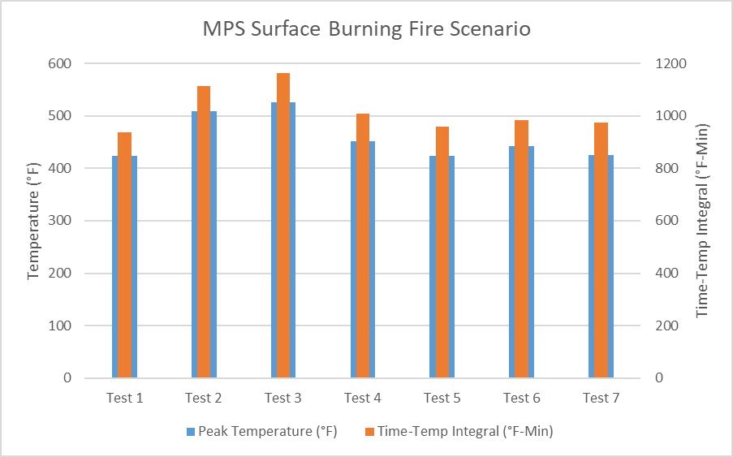
Surface Burning Fire Scenario Chart
Centered underneath T/C

Slide 17
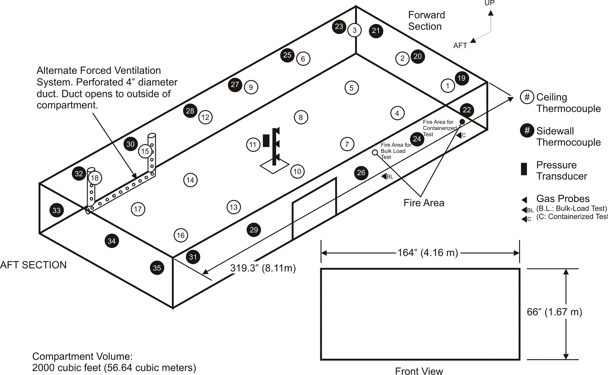

Slide 18
Surface Burning Fire Scenario
Clarify the positioning of the pan location
  “Most difficult location”
  Specify relationship to a ceiling thermocouple

Slide 19
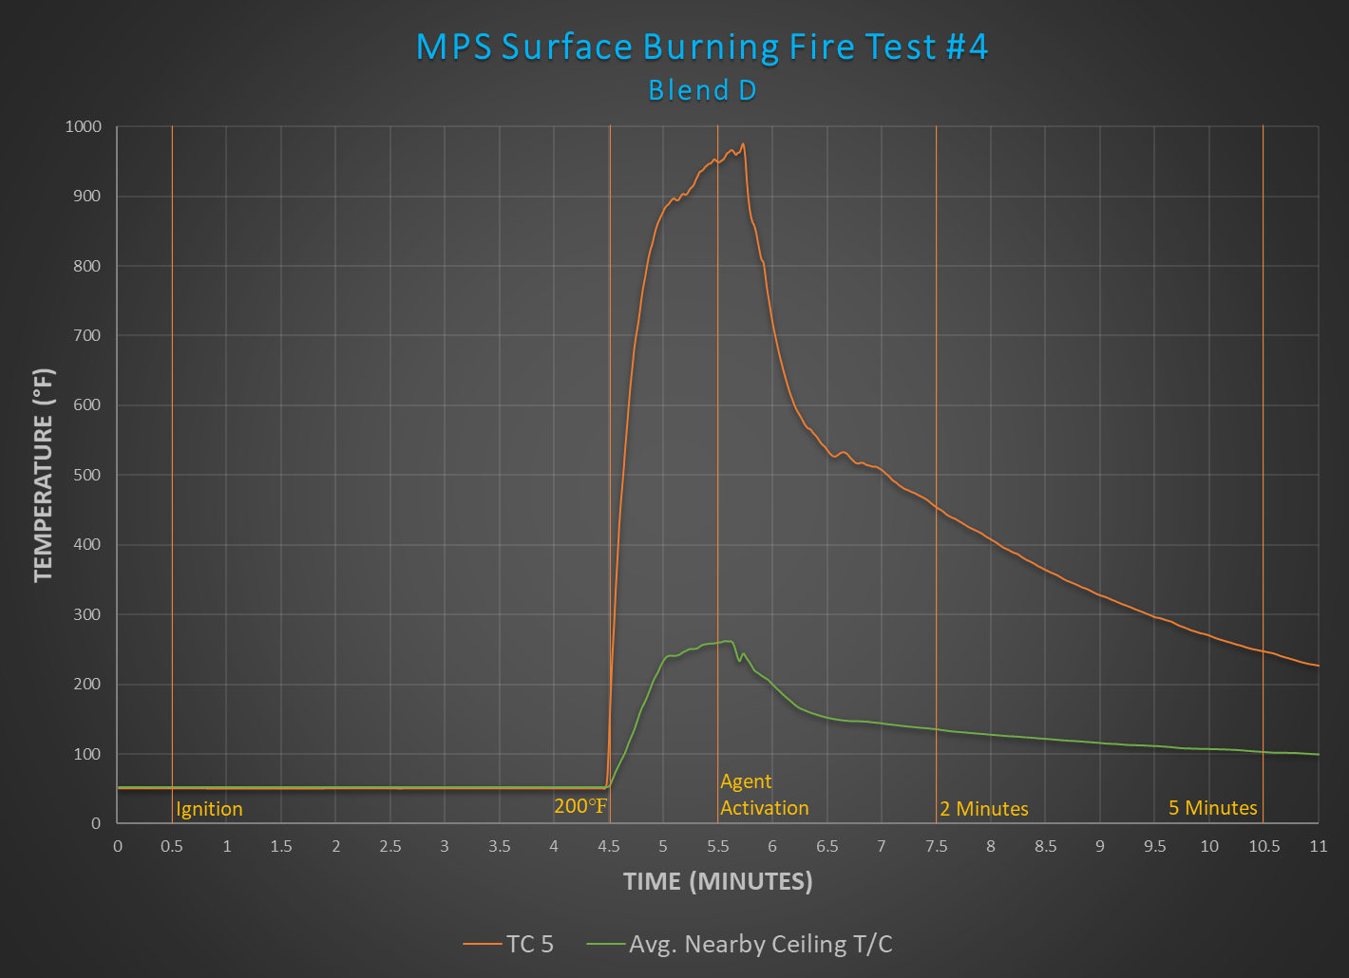
Notes:
Igniton took long time. So recommending a nichrome wire ignition method to be added to the standard.

Slide 20
Challenge Fire Scenario
Pallet Configuration
50 - 18650 Li-ion Cells @ 50% SOC
500 ml denatured ethanol
1 gallon ethanol
Ignition source
17 – Boxes filled with 2.5 lbs of shredded paper
8
2
4
5
6

Slide 21
Challenge Fire Scenario
Rename the scenario
Still developing the test setup, methodology, and acceptance criteria
  Vary the state of charge of the cells
  Increase the duration of the test
  Add variety of cell types (portable batteries, laptop batteries, etc.)

Slide 22
Old Analysis
New Analysis
2nd
1st
3rd
4th
1st
5th
peak | TC # | Temperature
1st | #7 | 682.1 °F
2nd | #4 | 599.7 °F
3rd | #5 | 574.9 °F
4th | #1 | 474.3 °F
5th | #11 | 434.8 °F
Test | TC# | Temperature
#1 | #7 | 682.1 °F
#2 | #5 | 444.3 °F
#3 | #5 | 485.4 °F
#4 | #2 | 314.3 °F
#5 | #5 | 304.9 °F
Average of Test #1 553.1 °F
Acceptance Criteria 710.0 °F
Average over all Tests 365.8 °F
Acceptance Criteria 710.0 °F
Average over all Tests 446.2 °F
Acceptance Criteria 710.0 °F
Comparison Average vs. Criteria is done for average of highest 5 peaks of each individual Test out of the total of 5 Tests.
Comparison Average vs. Criteria is done for average of highest single peak of each Test over all Tests.

Slide 23

Acceptance Criteria
Change the criteria from a time-temperature integral (°F-Min) to an average temperature (°F) over the same time period.

Slide 24
Additional Topics
Toxicity
  Include the details to measure acid gases in the standard.
Air Leakage Rate
  Specify the methodologies that can be used to calculate the leakage rate of the compartment.

Slide 25
Future
Halon Replacement Handbook
  Develop a handbook that includes all the Halon replacement standards in one document.
  Adopt the “living document” approach to be able to make changes to the document more easily.

Slide 26

Questions?
Contact Info:
Dhaval Dadia
dhaval.dadia@faa.gov
609-485-8828 (W)

